Slide 1
Looping in Python
By : Muhammad Umer

Slide 2
Looping in Python
In computer programming, a loop is a sequence of instructions that is repeated until a certain condition is reached.
Looping is an iterative process in programming through which we can perform any specific operations as many times we want.
Python provides us two kind of loops :
For loop
While loop
In order to use for loop we have to use for keyword of python and for while loop we have to use while keyword.

Slide 3
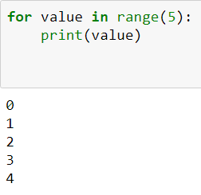
For loop
For loop can iterate over a sequence of statements using the "range" functions.
1st iteration : value=0
2nd iteration : value=1
3rd iteration : value=2
After 1st Iteration
4th iteration : value=3
After 2nd iteration
After 3rd iteration
5th iteration : value=4
After 4th iteration
After 5th iteration

